Slide 1
Empowering Knowledge: The Tech-Driven Revolution in Scholarly Publishing
Leveraging Technology for a New Era of Scholarly Dissemination
Prof. Dr. Zabta Khan Shinwari
Distinguished National Professor/ Prof. Emeritus, Quaid-i-Azam University, Islamabad-Pakistan. Fellow, The World Academy of Sciences (TWAS); PAS & Vice President Islamic World Academy of Sciences

Slide 2
Definition of Scholarly Publishing
Scholarly publishing refers to the process of disseminating academic research and knowledge to the broader scholarly community and the public.
It involves the formal publication and distribution of research findings, academic papers, articles, books, and other scholarly works that have undergone rigorous evaluation and peer review.
Scholarly publishing plays a vital role in advancing scientific, social, and cultural knowledge, facilitating the exchange of ideas, and promoting intellectual discourse among researchers, scholars, and practitioners worldwide.

Slide 3
Traditional Challenges in Scholarly Publishing
Lengthy Publication Processes
Limited Access to Research
High Costs and Sustainability
The rise of technology is changing the landscape of scholarly publishing.
Increased efficiency and accuracy in research activities due to artificial intelligence (AI
2. Rapid disseminations making knowledge widely accessible through open access publications, which are permitted free use by readers worldwide without any need for payment or prior registration with publishers or libraries.
3. Fewer delays from traditional peer-review processes towards automated systems
4. Improved control over intellectual properties incentivizing creative professionals allowing them greater educational rewards directly received related to their innovative work

Slide 4
Digital Transformation in Scholarly Publishing
The Role of Technology in Streamlining Publishing Workflows
Here are some key roles of technology in streamlining publishing workflows:
Online Manuscript Submission and Peer Review Systems:
Editorial Management Systems: Modern publishing workflows utilize editorial management software that facilitates smooth communication between authors, editors, and reviewers. ensure timely decision-making.
Plagiarism Detection: prevent potential issues related to originality, safeguarding the integrity of published work.
Digital Publishing Platforms: Journals and books can now be published online, immediate access to readers worldwide
Open Access Initiatives: Open access promotes wider dissemination of knowledge, increased visibility for authors, and greater impact for research.
Preprint Servers:
Collaborative Writing Tools: Cloud-based collaborative writing tools facilitate real-time collaboration among co-authors. These tools enhance efficiency, version control, and simultaneous editing.
Digital Object Identifiers (DOIs): DOIs are widely used to link research outputs to the scholarly community.
Data Archiving and Repositories: Metadata and Searchability: Artificial Intelligence (AI) and Machine Learning: streamline peer review, assess article relevance,

Slide 5
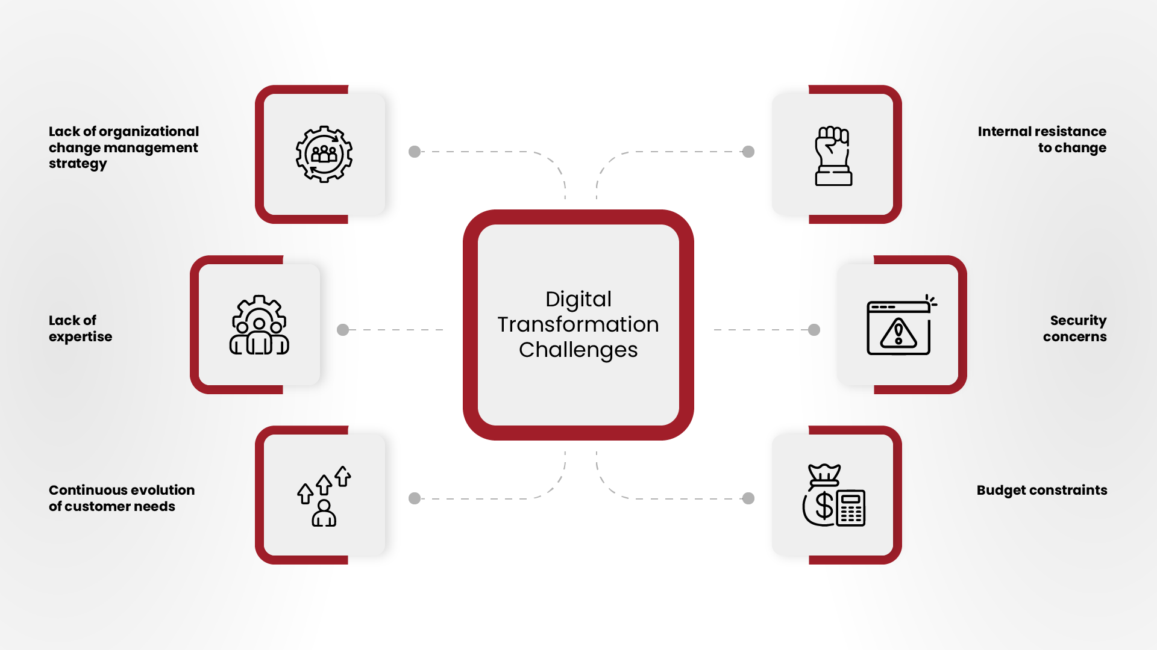
@E_Minchenberg
We must make sure #ArtificialIntelligence is developed for us and not against us. To harness #AI for social good, it must be ethical & human-centered.
Expertise needed: Cloud Computing
Artificial Intelligence and Machine Learning
Mobile app development
User Experience (UX) design
Blockchain; Cybersecurity; DevOps

Slide 6
Open Access Initiatives and Increased Accessibility
Open Access (OA) initiatives have emerged as a transformative force in the scholarly publishing landscape, aiming to make research freely accessible to readers worldwide without any cost barriers.
Unrestricted Access:
Global Reach: OA initiatives break down these barriers, facilitating the global dissemination of knowledge to researchers and institutions in both developed and developing countries.
Societal Impact: Policymakers, educators, and practitioners can make informed decisions based on the latest evidence, fostering positive change.
Collaboration and Interdisciplinary Research: This cross-pollination of ideas leads to innovative research outcomes and holistic problem-solving.
Enhanced Visibility and Citations:
Accelerating Scientific Progress:
Public Engagement: Lay audiences, educators, and journalists can access and understand research findings, leading to better science communication and public awareness.
Preservation and Long-Term Availability: This safeguards research outputs against loss or degradation.
Funding Agency Compliance:
Empowering Early-Career Researchers: OA allows early-career researchers to gain visibility and recognition for their work, providing a level playing field for researchers at various career stages.
In conclusion, Open Access initiatives play a crucial role in democratizing access to scholarly knowledge. By breaking down barriers and fostering inclusivity, OA increases the visibility, impact, and societal relevance of research. Embracing OA not only accelerates scientific progress but also creates a more equitable and interconnected global research community.

Slide 7
Digital Repositories and Preservation
Here's why digital repositories and preservation are crucial:
Long-Term Archiving: guaranteeing that valuable research remains available for future generations.
Research Data Management: promoting transparency and reproducibility in research.
Citations and Recognition: Citations also facilitate tracking the impact and influence of research outputs.
Institutional and Disciplinary Repositories: Disciplinary repositories cater to specific fields, curating content relevant to those domains.
Supporting Open Science:
Version Control and Persistent Identifiers: Persistent identifiers (e.g., DOIs) assigned to repository content ensure permanent access and easy citation.
Supporting Research Assessment: such as tenure and promotion evaluations. Institutions and funding agencies can use repository data to assess researchers' productivity and impact.
repositories support collaboration, innovation, and the advancement of knowledge across academic disciplines.

Slide 8
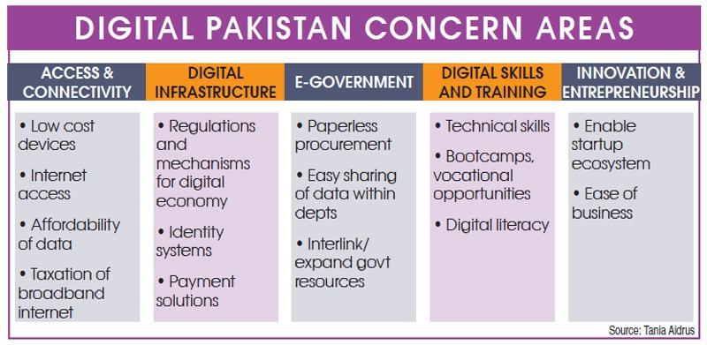
Cultural Dimension 3: Long-term Orientation
Some LMICs have a long-term orientation, valuing tradition, preserving heritage, and maintaining social stability.
Digital ethics should respect cultural heritage, protect indigenous knowledge, and promote responsible innovation.
Balancing technological progress with cultural preservation is a critical aspect of digital ethics in these contexts.
Source: DAWN Jan 3, 2020
Situationer: The ‘Digital Pakistan’ challenge

Slide 9
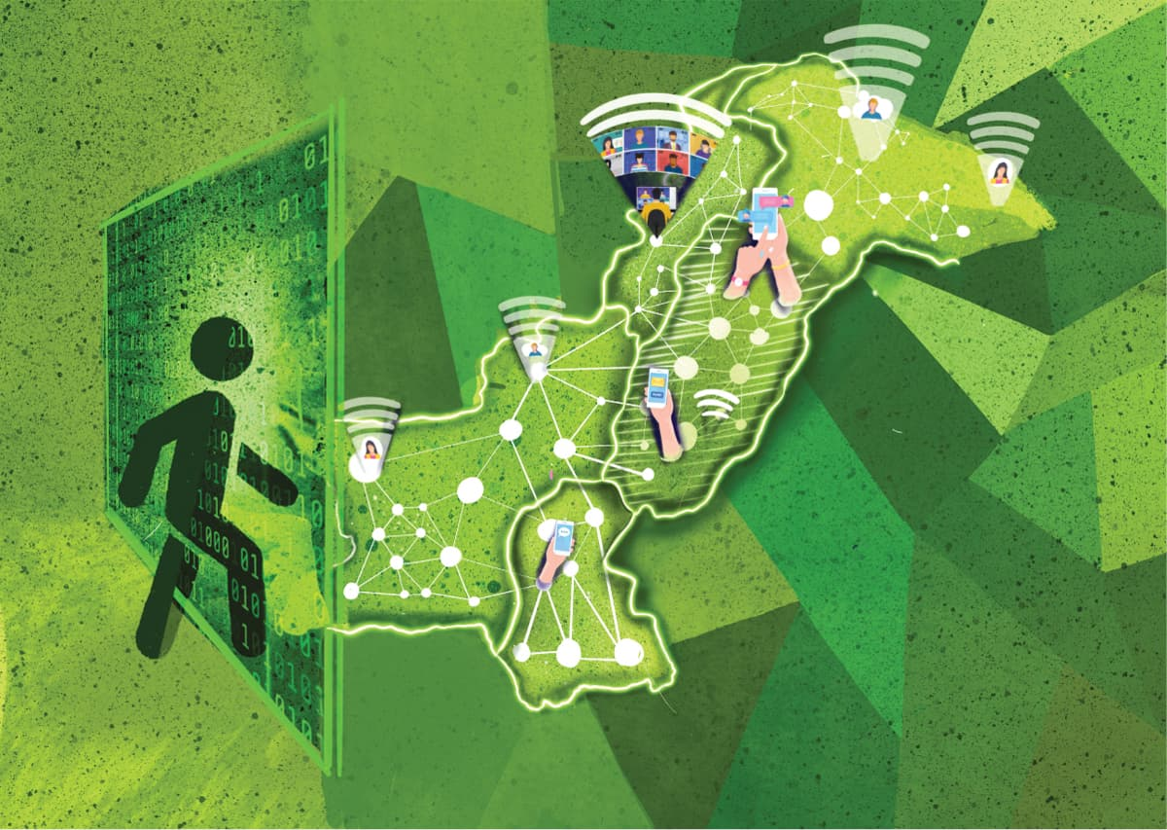
Automated Peer Review Systems
AI and Machine Learning in Peer Review Process
Enhancing Efficiency and Quality of Reviews
Ensuring Fairness and Unbiased Evaluations
CAN ‘DIGITAL PAKISTAN’ BECOME A REALITY?
DAWN July 25, 2021

Slide 10
Enhanced Collaboration and Global Reach
Enhanced academic collaboration – New technology tools have improved opportunities for remote collaborations among international academics across different fields which have enabled joint authorship on journal articles that promote multidisciplinary exploration into research trends related to global transformations.
Virtual Conferences and Online Collaboration Tools
Breaking Barriers of Geographical Boundaries
1. The increasing availability of online platforms for publishing research. Platforms such as ResearchGate and Academia have made it easier than ever before to publish and disseminate academic work.
2. Increasing collaboration between authors, editors, and publishers due to lower communication costs associated with digital media versus traditional print media production processes. Collaborative Research Networks

Slide 11
‘Good digital future’ within LMIC cultural context?
Inclusive Access: A good digital future would ensure equitable access to digital technologies, bridging the digital divide within and between countries. Efforts should be made to provide affordable internet connectivity, digital infrastructure, and devices to underserved communities, ensuring that no one is left behind.
Cultural Preservation: Embracing cultural diversity and preserving local traditions, languages, and knowledge is vital. A good digital future would promote the preservation and representation of LMIC cultures in the digital sphere, enabling communities to share and celebrate their heritage globally.
Empowerment and Participation: Digital technologies should empower individuals and communities, enabling active participation in decision-making processes. LMICs should foster digital literacy, providing the necessary skills and knowledge for people to navigate the digital landscape, express themselves, and engage in civic discourse.
Ethical Digital Practices: A good digital future within LMICs would prioritize digital ethics and responsible digital behavior. This includes protecting individual privacy and data rights, promoting transparency and accountability, and combating online harassment and misinformation. Culturally sensitive frameworks for digital ethics should be developed, incorporating the values and norms of local communities.
Socioeconomic Development: Digital technologies have the potential to drive socioeconomic development in LMICs. A good digital future would leverage technology to foster innovation, entrepreneurship, and job creation, enabling economic growth and poverty reduction.
Collaborative Partnerships: Achieving a good digital future requires collaboration between governments, civil society, academia, technology providers, and international organizations. Stakeholders should work together to establish policy frameworks, invest in digital infrastructure, and promote knowledge sharing to ensure a collective effort towards a sustainable and inclusive digital future.

Slide 12
Innovative Publishing Formats
Improved data management systems – Digital archiving technologies allow for much better organization of large volumes of content available online including peer reviewed papers published within university presses or project outputs generated during collaborative partnerships between universities/colleges etc., but finding these materials would not be so easy without digital cataloguing initiatives that ensure content remains accessible even after decades pass since its original publication date(s).
Interactive Multimedia Publications
Data Visualization and Infographics
Augmented Reality in Research Communication

Slide 13
Codes of conduct, standards, and guidelines
(Codes of conduct, standards, and guidelines.) An example of Bioethics, Biosafety and Biosecurity. Dual Use of Education (Pak as an example for LMIC).
Innovation can also contribute to the development and implementation of digital ethics frameworks, such as codes of conduct, standards, and guidelines. This can create a culture of responsible innovation and help address emerging ethical concerns in the digital space.
In conclusion, global innovation and digital ethics are two interconnected concepts that are essential for creating a sustainable, inclusive, and ethical digital future. By promoting responsible innovation and ethical considerations in the development and use of technology, we can ensure that these innovations serve the common good and contribute to a better world for all.

Slide 14
Ethical principles for digital transformation
Design for privacy, security and integrity
Promote trust
Beware of bias
Unintentional ethical behaviour (interpret information in a way that that confirms their beliefs, hypotheses or expectations and dismiss opinions and information that are contrary to these.)
Ensure there is accountability
Promote an ethical culture (digital transformation has the potential to create opportunity, value and success at all levels within the organisation, these must be achieved through fairness, honesty and integrity. )

Slide 15
The Impact of Social Media
Engaging with a Wider Audience
Building Researcher Profiles and Networks
Disseminating Research Findings
The tech-driven revolution in scholarly publishing has been an empowering force for knowledge.
1. The advent of digitalisation technologies such as artificial intelligence (AI) and machine learning (ML), which have enabled publishers to create better and more innovative products that facilitate research publication across multiple platforms.
2. Increased utilization of cloud computing technology, which helps scholars store data conveniently while reducing cost significantly.
3. Viral access models for published content, which allow readers to gain free or low-cost access to high quality publications from their preferred providers with minimal effort .
4. Easy accessibility & searchability afforded by open science initiatives like PubMed Central & DOAJ make it easier for researchers/students to find relevant peer reviewed resources quickly without any upfront costs, thereby increasing reach & engagement drastically!

Slide 16
Blockchain Technology in Scholarly Publishing
Blockchain technology is making its mark in various industries, and scholarly publishing is no exception. Blockchain's decentralized and immutable nature offers several potential benefits that can address some of the challenges faced by the scholarly publishing community. Here's how blockchain technology is being explored in scholarly publishing:
Intellectual Property Protection: Blockchain can be used to establish proof of ownership and timestamp the creation of scholarly works. This helps in protecting intellectual property rights and preventing unauthorized use or plagiarism.
Copyright Management: Smart contracts on blockchain can automate copyright licensing and permissions. This streamlines the process of granting usage rights and ensures that authors receive fair compensation for their work.
Transparent Peer Review: Blockchain-based peer review systems can enhance transparency and integrity in the peer review process. All actions and feedback can be recorded on the blockchain, providing an auditable and tamper-resistant record of the review process.
Research Data Integrity: Blockchain can be utilized to create secure and unalterable records of research data. This ensures data integrity and prevents data manipulation or fraudulent practices.
Author Attribution: Blockchain can facilitate accurate and verifiable author attribution by creating a tamper-proof record of each author's contributions to a publication.

Slide 17
Blockchain Technology in Scholarly Publishing
Open Access and Micropayments: Blockchain-based micropayments and smart contracts can enable more efficient and transparent payment models for accessing paywalled content or supporting Open Access initiatives.
Digital Rights Management: Blockchain's decentralized ledger can be used to manage digital rights associated with scholarly content.
Retract and Correct: Blockchain can facilitate retractions or corrections of published research. Instead of removing content entirely, a retraction record can be added to the blockchain, maintaining transparency and historical context.
Academic Credentialing: Blockchain can be leveraged for secure and portable academic credentialing. This empowers individuals to own and control their educational records and certifications, enhancing employability and recognition.
Anti-Plagiarism and Duplicate Content Detection: Blockchain can assist in identifying and flagging duplicate content or plagiarism across the network, maintain the integrity of scholarly literature.
While blockchain technology shows promise for addressing challenges in scholarly publishing, it is still in its early stages of adoption. Implementing blockchain solutions requires overcoming technical, governance, and scalability issues. However, ongoing research and pilot projects demonstrate the potential for blockchain to reshape scholarly publishing practices, promoting transparency, authenticity, and accessibility in academic communication.

Slide 18
Secure and Transparent Transactions
Intellectual Property and Copyright Protection
Eliminating Fraudulent Publications
The proliferation of technological tools that facilitate online communication.
Increasing digital literacy across countries worldwide has enabled researchers in developing nations improved access traditional methods within international academic circles - giving them an equal footing when attempting publication on global stages with established scholars based at Western universities who often have significant resources benefitting their career success far beyond what can traditionally be accessed by peers outside these privileged positions within academia
Challenges and Concerns
Data Privacy and Security; Digital Divide and Accessibility Issues
Quality Assurance in a Tech-Driven Environment

Slide 19
Transforming academic scholarship
Future Trends and Opportunities
Artificial Intelligence Advancements
Mobile Publishing and E-Readers
Collaborative Open Peer Review
Other notable changes:
"publish or perish" qualifications are increasingly evaluated based primarily on impact metrics rather than volume;
peer review processes have adopted alternative models such as post-publication reviews instead of solely pre-publication reviewing;
social media networks encourage interdisciplinary dialogue exchanges among scholars from diverse disciplines;
machine learning algorithms can expedite the editorial process through automated filtering of articles submitted for publication according to their relevance criteria;
access barriers imposed by expensive journal subscriptions have become eliminated with open access movement due to mandates made by funders, universities and research institutions worldwide,
Conclusion
Embracing the Digital Transformation
Empowering Scholars and Advancing Knowledge
Building a Bright Future for Scholarly Publishing

Slide 21
Generative AI-specific ethical concerns
Truthfulness & Accuracy (pre-trained language models like ChatGPT lack the ability to update and adapt to new information Stanford Uni. report AI 2022).
Copyright ambiguities
Misuse of generative AI
Education: Generative AI has the potential to be misused by creating false or inaccurate information that is presented as true. (Chat GPT to prepare their homework on a wide range of subjects.
Marketing: It can be utilized for unethical business practices, such as artificially inflating online reviews for marketing purposes
Social engineering: Generative AI can be abused to generate convincing and realistic-sounding social engineering attacks, such as phishing emails or phone scams to reveal sensitive information.
Public opinion manipulation: There have been well documented cases where nation states interfered in elections. For example: Synthetic humans can be generated with realistic faces and persuasive statements in text or video form.
How to navigate these dilemmas?
Transparency
Explainability
Inclusiveness
Alignment

Slide 22
Thank You ACSE
If We All Work Together As A Team, We Will Achieve Our Goals!

